Slide 1
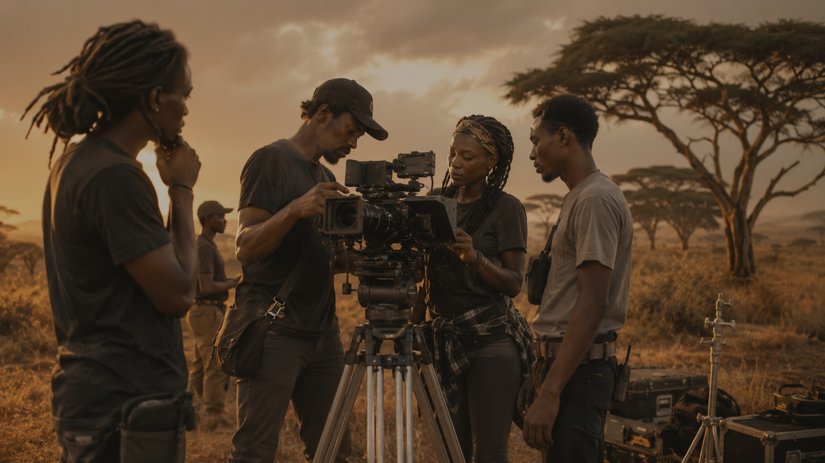

COMPANY PRESENTATION
Your Africa
Production Partner
Rooted stories. Global screens.
Field-tested execution.
Kenya-based | East Africa experience | UAE & Canada ties | 25+ years in film
With Plan Africa there will be no need for Plan B.

Slide 2
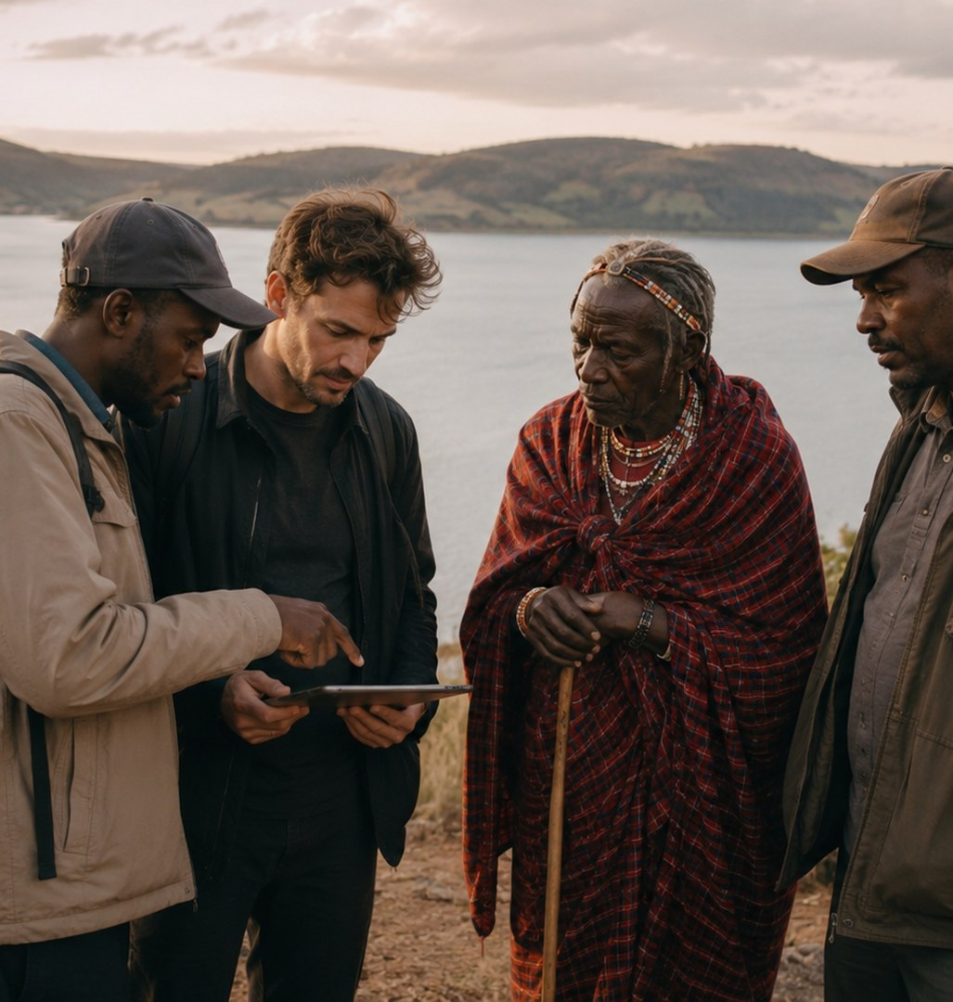
BRAND PLATFORM
Local knowledge.
Global production standards.
Plan Africa translates complex African production environments into clear, workable plans - so clients can focus on the story, the shot and the vision.
Primary positioning: Your Africa Production Partner
Emotional anchor: Rooted Stories. Global Screens.
Operational promise: No Plan B needed.
www.PlanAfricaProductions.com

Slide 3

WHO WE ARE
A Kenyan base with regional reach and international fluency
Based in Nairobi, Plan Africa bridges international expectations with African operating realities across East Africa, supported by strong ties to the UAE and Canada.
• 25+ years across the film industry
• Original productions with social impact purpose
• Full ground support for foreign shoots
• Field logistics for film and non-film projects
The trusted local interface between international ambition and African operating reality.
www.PlanAfricaProductions.com

Slide 4
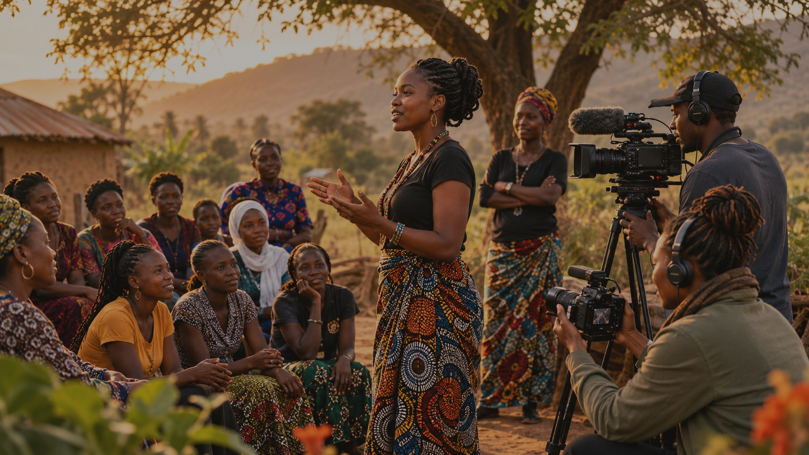
ORIGINAL PRODUCTIONS
Films with purpose, dignity and social impact
Plan Africa creates stories that show strength, change and possibility from the ground up.
• Women's rights and empowerment
• Success stories and practical change
• Youth, hope and the next generation
• Human-centered stories for global audiences
www.PlanAfricaProductions.com

Slide 5
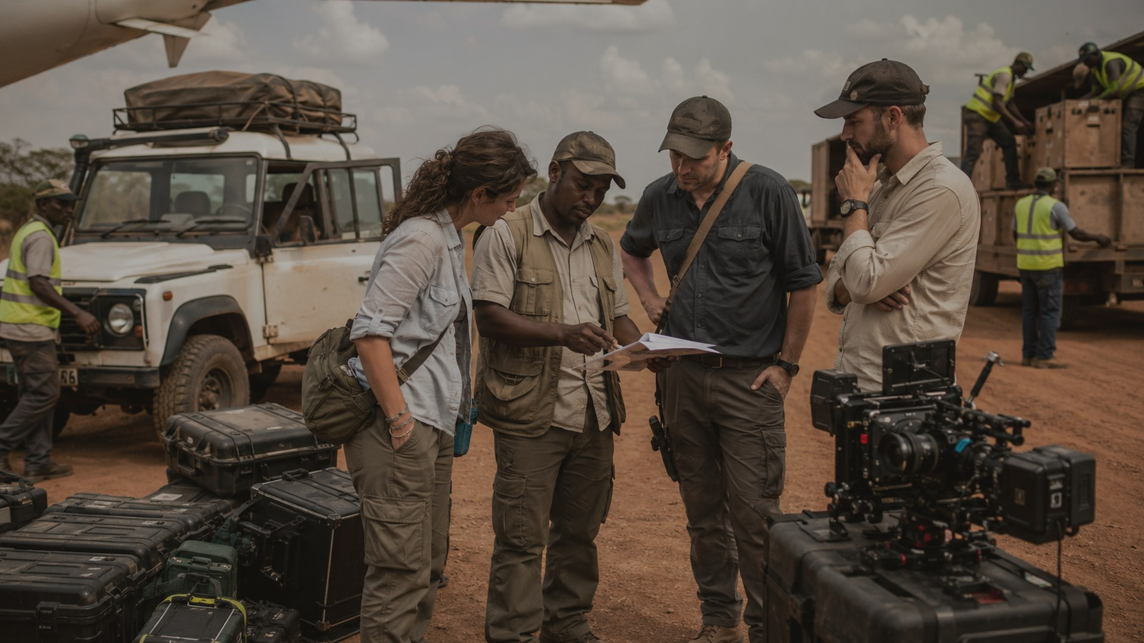
PRODUCTION SUPPORT
You focus on the shot. We handle the ground.
For foreign films, documentaries, television, commercials and institutional productions, Plan Africa manages the local realities that determine whether a shoot moves smoothly.
• Scouting, site selection and access
• Permits, permissions and local liaison
• Crew, equipment, transport and welfare
• Daily troubleshooting from arrival to wrap
www.PlanAfricaProductions.com

Slide 6

FULL SERVICE SUITE
The support chain
Film shoot planning and support services
01
Planning
Feasibility, budgets, schedules and supplier plans
A complete ground-services platform for productions in Africa.
02
Locations
Scouting, site selection, access and alternatives
03
Permissions
Permits, authorities, communities and landowners
• Built for productions that need speed, confidence and local clarity.
• Designed to protect shooting time and reduce operational uncertainty.
• Supported by deep local industry knowledge and practical field experience.
Crew
Fixers, field producers, managers and local specialists
04
05
Equipment
Temporary import, clearance, storage and re-export
06
Logistics
Transport, accommodation, catering and field welfare
www.PlanAfricaProductions.com

Slide 7
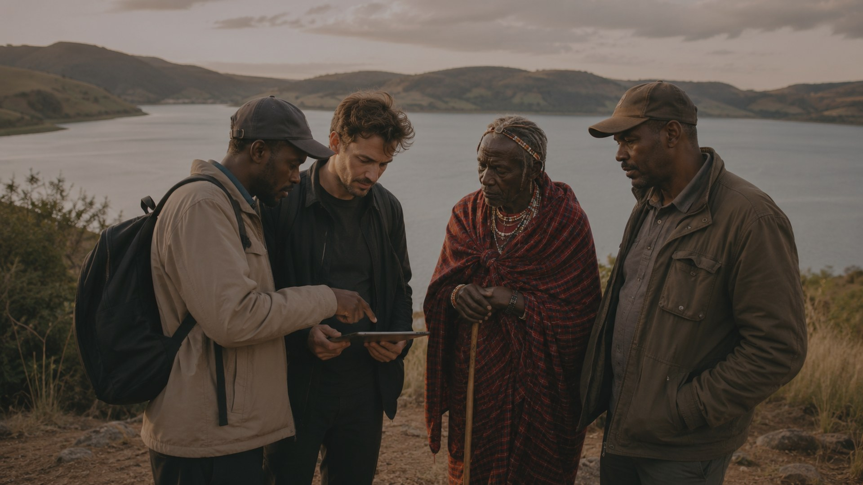
LOCATIONS AND PERMISSIONS
From idea to accessible location
Plan Africa helps productions find, assess, negotiate and secure the locations that best support the creative vision.
• Location scouting, photography and video previews
• Government, county, park, private land and community access
• Drone, restricted-area and special-use coordination where applicable
• Stakeholder engagement and local protocols
www.PlanAfricaProductions.com

Slide 8
EQUIPMENT AND MOVEMENT
Temporary import, clearance and field movement
Plan Africa plans the path of equipment and people before the first case reaches the ground.
• Cameras, lenses, drones, lighting, grip, sound and specialist gear
• Customs documentation and airport arrival support
• Secure transport, storage and equipment protection
• 4x4s, drivers, fuel, routes and remote-area contingencies
www.PlanAfricaProductions.com

Slide 9
CREW WELFARE AND LOCAL LOGISTICS
Keep the crew productive, safe and supported
Accommodation, catering, transport and daily field coordination are not side issues. They are the operating base of a successful shoot.
• Hotels, lodges, camps and guesthouses
• On-set catering, craft services and water
• Guides, translators and local liaison officers
• Daily movement plans and field troubleshooting
www.PlanAfricaProductions.com

Slide 10
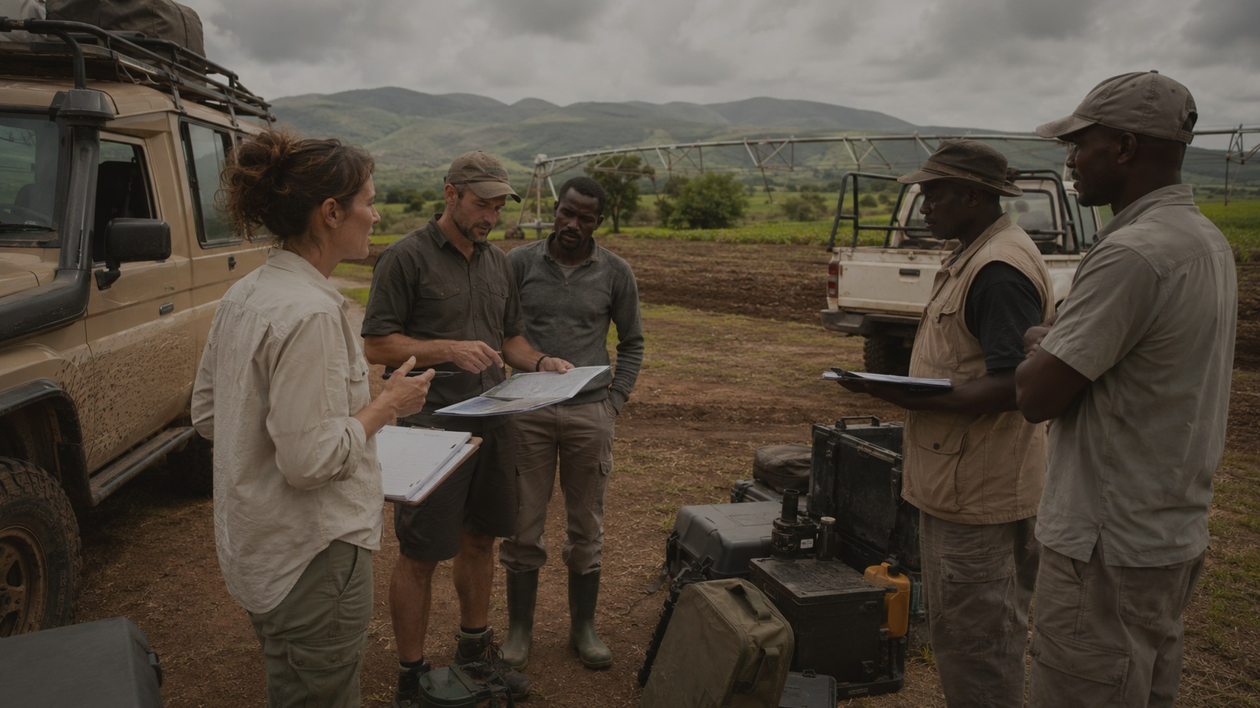
LOCAL INTELLIGENCE
Translating challenging environments into workable plans
Terrain, weather, roads, community protocols, supplier reliability and official permissions can shape the shoot. Plan Africa turns those variables into a clear production plan.
• Risk and field-readiness planning
• Cultural and community briefings
• Safety, medical and emergency routing where required
• Real-time issue resolution during the shoot
www.PlanAfricaProductions.com

Slide 11
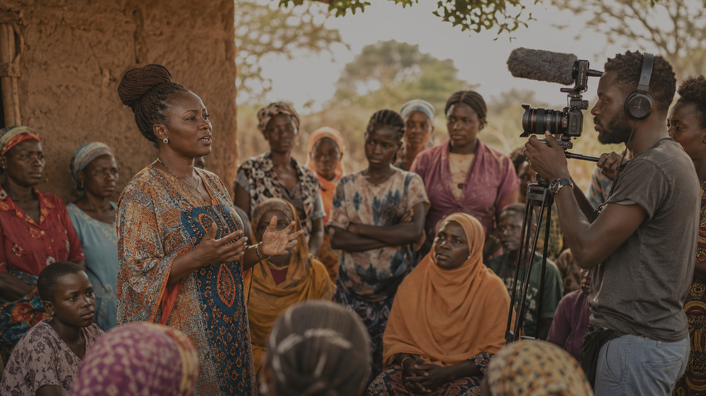
BEYOND FILM
Contracted logistics for African projects
The same field intelligence used for productions can support NGOs, research teams, corporate missions, infrastructure site visits and institutional assignments.
• Site scouting and feasibility checks
• Partner and supplier identification
• Transport, accommodation and field movement
• Guides, translators and local liaison
• Ground intelligence and operating briefings
www.PlanAfricaProductions.com

Slide 12
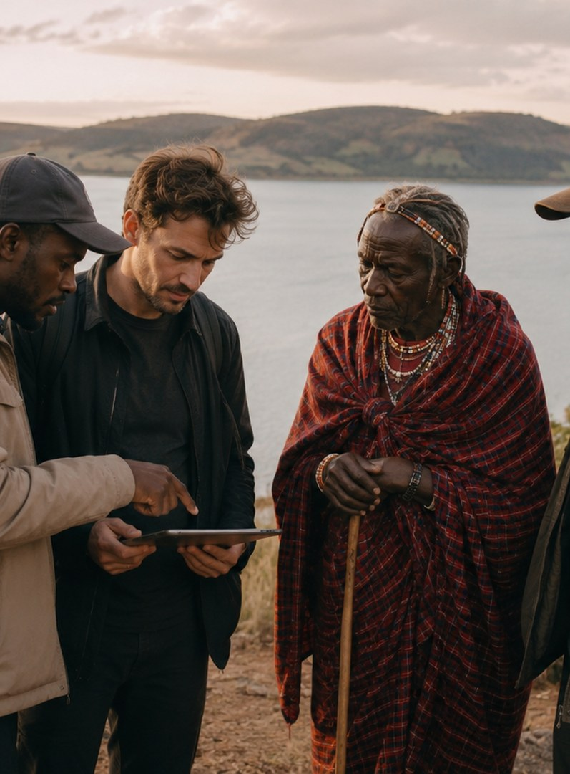
HOW WE WORK
A practical operating model from brief to wrap
01
Brief and feasibility
Clarify intent, budget, constraints and risk tolerance.
02
Scout and secure
Identify sites, assess access and engage stakeholders.
03
Build the ground plan
Create the schedule, permits, logistics and contingency structure.
04
Mobilize
Coordinate arrivals, customs, suppliers, vehicles and field base.
05
Support the shoot
Manage daily logistics, access, liaison and real-time issues.
06
Close out
Reconcile suppliers, close locations and support re-export.
Anticipate. Prepare. Translate. Deliver.
www.PlanAfricaProductions.com

Slide 13
REGIONAL REACH
Kenya roots. East Africa reach. UAE and Canada ties.
Plan Africa connects local production realities with international expectations, helping teams move from concept to field execution with confidence.
• Nairobi base with regional fluency
• East Africa project experience
• Strong relationship ties to the UAE and Canada
• Practical bridge between foreign teams and African environments
www.PlanAfricaProductions.com

Slide 14
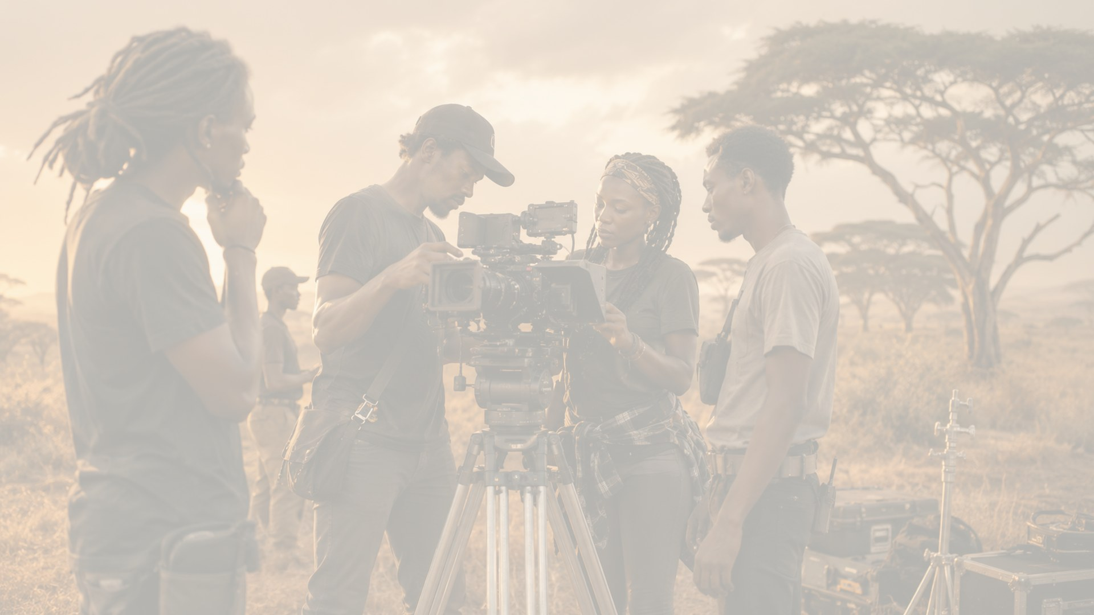
WHY PLAN AFRICA
The local intelligence behind the production
25+ years
Across all aspects of the film industry
Social impact
Original films rooted in women, youth, hope and change
Local access
Permissions, communities, locations and operating realities
Field capacity
Film and non-film logistics for African projects
Anticipatory planning
Understanding what teams need before they need it
With Plan Africa there will be no need for Plan B.
www.PlanAfricaProductions.com

Slide 15
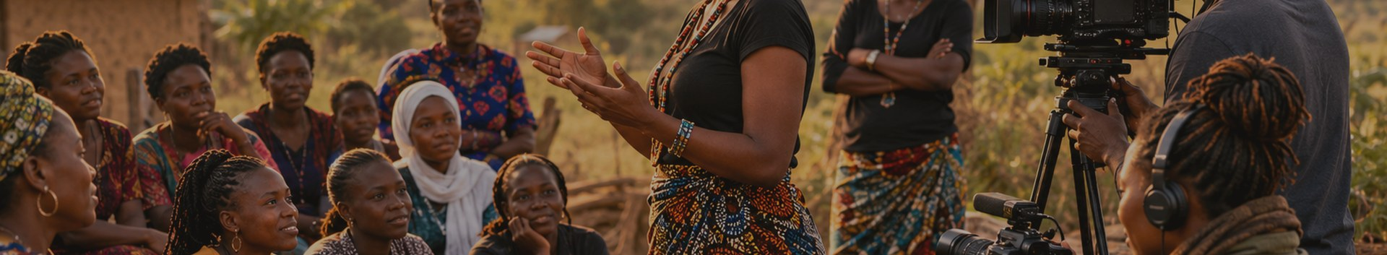
Website
www.PlanAfricaProductions.com
Primary contact
Shiko@PlanAfricaProductions.com
CONTACT
General email
Plan Africa Productions
info@planafricaproductions.com
Your Africa Production Partner
Address
PO Box 21448 Ngong Road, Nairobi, 00505
With Plan Africa there will be no need for Plan B.

